Slide 1
Can AI Solutions replace human software engineers and data scientists?
An Analysis on GitHub Repositories and Commit History
Big Data and Cloud Computing Final Project
Iris Huang

Slide 2

Executive Summary
Project Overview
This comprehensive study leverages a 1.36 TiB GitHub Archive dataset with commits history, language and license information to understand evolving software development landscapes. The project will try to answer the question if AI solutions are able to replace human software engineers and data scientists after all the analysis.
Key Research Objectives
Analyze programming language trends
Investigate repository growth and technological innovations
Examine commit patterns and developer productivity
Key Takeaways
AI tools can replace repetitive work and boost productivity but can’t replace creativity and problem-solving.

Slide 3
Methodology
Data Source: GitHub Archive spanning multiple years
Preprocessing:
Removed irrelevant data.
Cleaned duplicates and erroneous entries.
Technologies: Apache Spark, PySpark, LSH, Pandas, Matplotlib
Analysis Techniques:
Exploratory Data Analysis (EDA).
Time-series analysis for trends.
Text similarity using LSH.
Visualization of languages, licenses, and commit messages.

Slide 4
Data Source Overview and EDA
Available Table Overview:
Commits: Unique Git commits from open source repositories on GitHub, including author information, repository information, subject, message, timestamp
265,419,190 Records
Languages: Programming languages by repository
3,325,634 Records
Licenses: Open source license SPDX code for each repository
3,325,634 Records
Contents: Unique file contents of text files under 1 MiB on the HEAD branch
281,191,977 Records
Files: File metadata for all files at HEAD
2,309,424,945 Records
Data Cleaning and filtering:
Table sample 1: 1% of data from Commits joined with languages and licenses on repo_name
Columns: Author.time_sec as timestamp, commit as an ID, author.name, subject, message, repo_name, languages, license, date (converted from time_sec)
Committer name is used for committer analysis.
Time used in the analysis: 2008-2022 (GitHub was built in 2008, and the last extensive data available was in 2022)

Slide 5
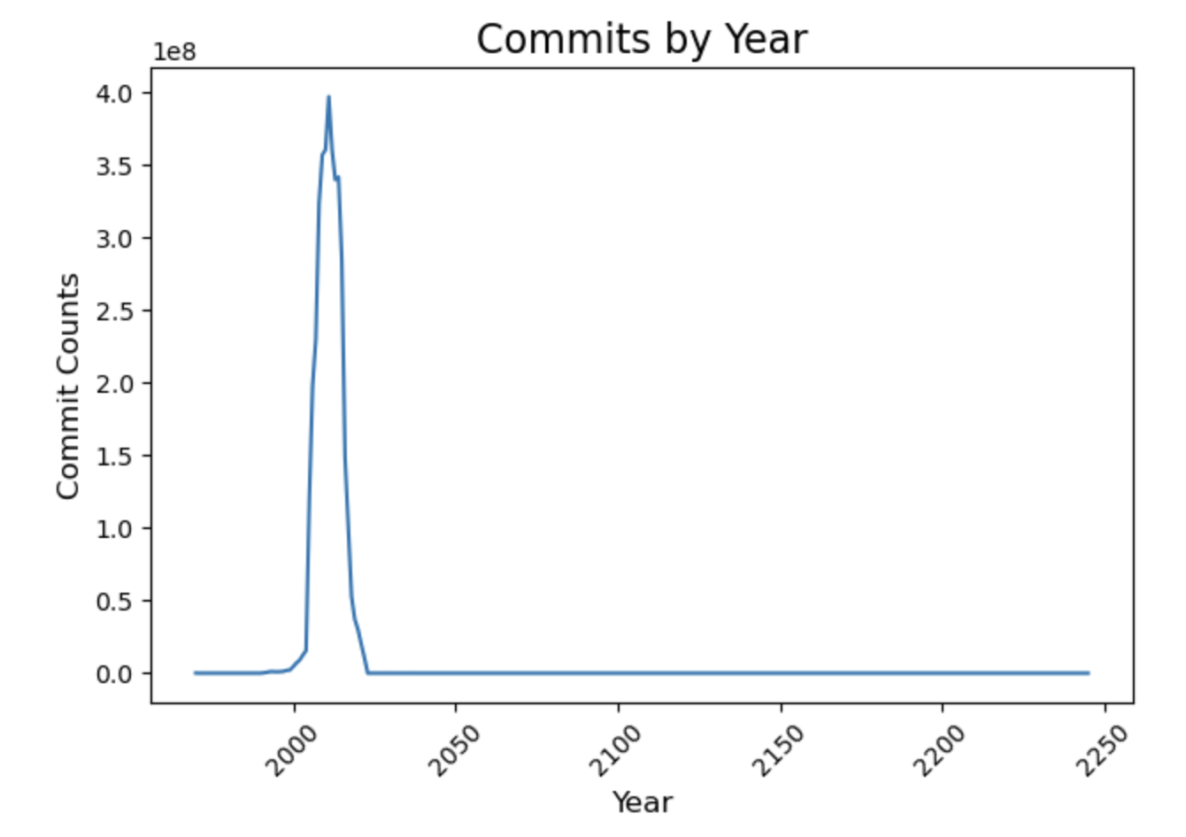
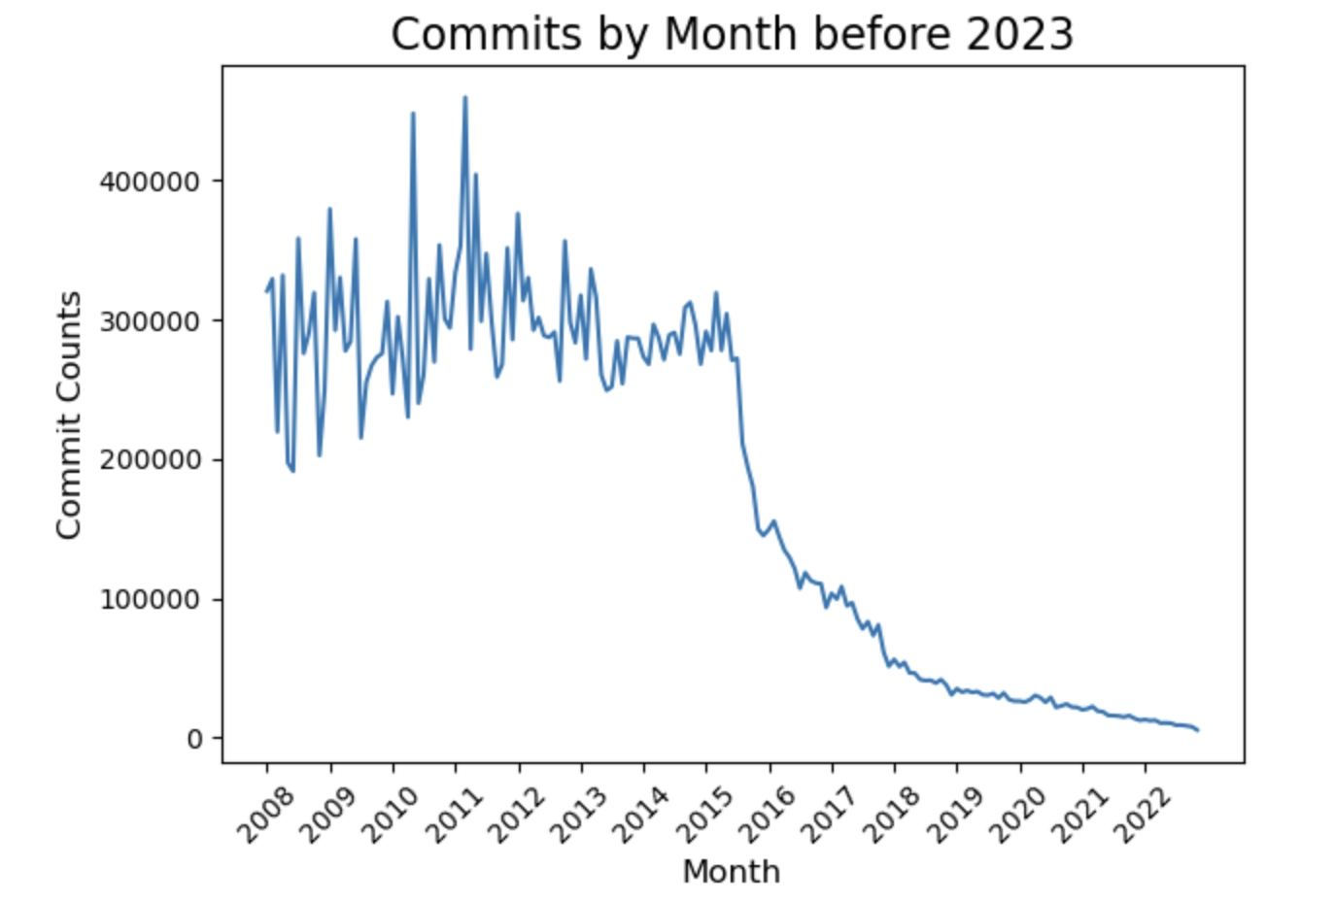
The dataset contains commit data from 1970 to 2030. Between 2008 and 2015, the number of commits remained relatively stable, peaking in 2011. However, after 2015, the number of commits experienced a significant decline

Slide 6
Time Series for all data

Slide 7
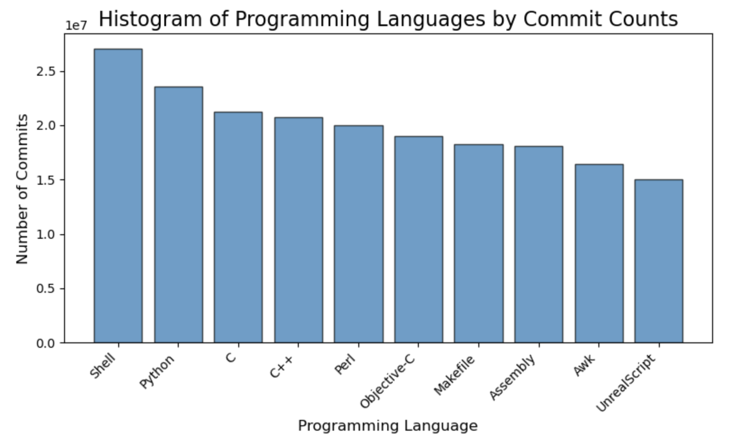
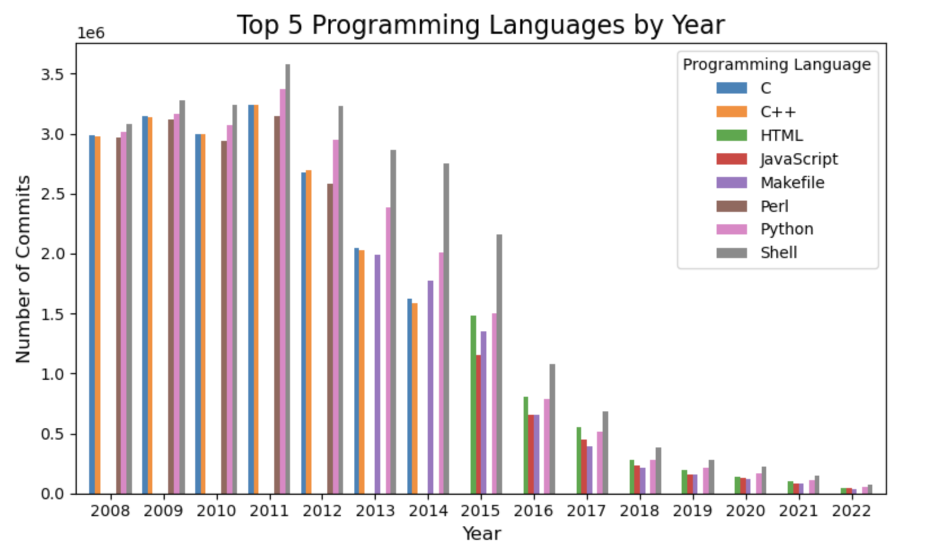
Python has always been the most popular programming language on GitHub. However, the second popular language has changed from C/C++ to Javascript since 2015
Color changed in 2015, from C/C++ to javascript/html

Slide 8
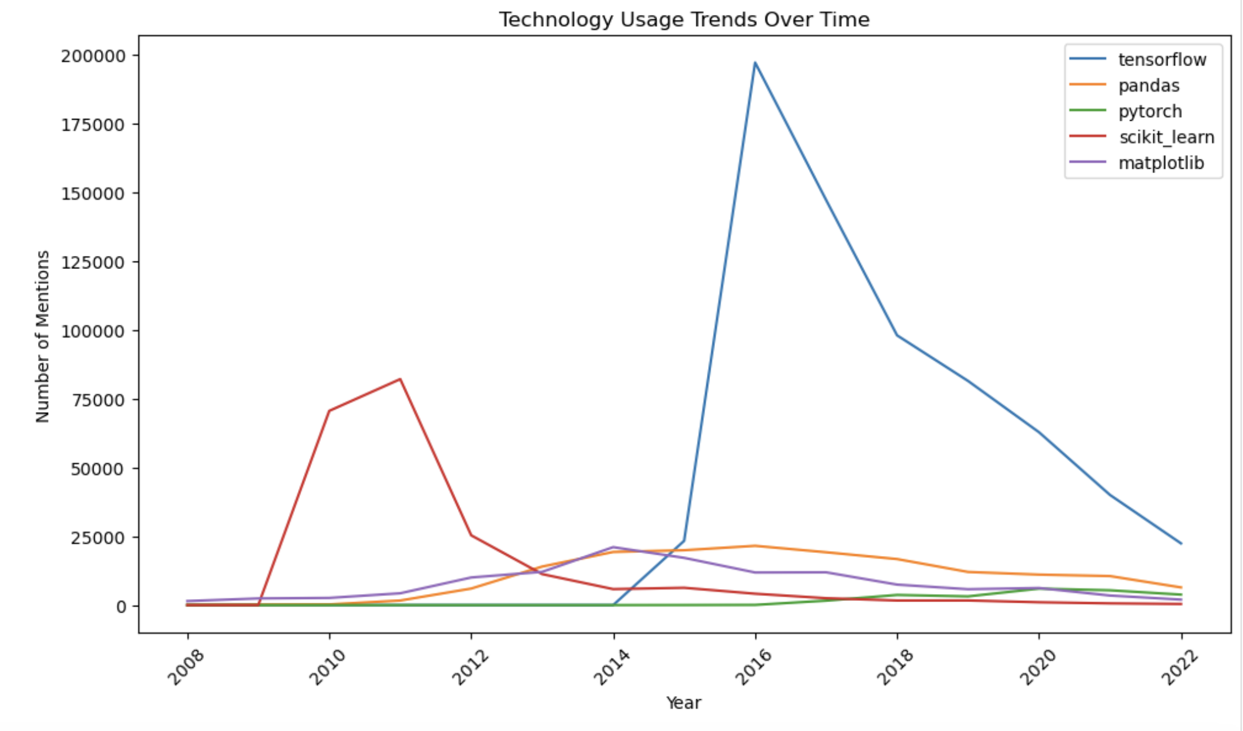
The popularity of data science packages evolves over time. While scikit-learn dominated in the early 2010s, TensorFlow gained significant traction in the late 2010s, and PyTorch has become more popular since 2020

Slide 9
GPL-2.0 is the most commonly used license, with a significantly higher number of commits compared to other licenses such as MIT and Apache-2.0. Interestingly, there is a noticeable correlation between licenses and programming languages, as each license exhibits a distinct distribution of the most popular programming languages
License | Top Language
Gpl-2.0 | C, Python
mit | Javascript
Apache-2.0 | Python
Bsd-3-clause | Python, Javascript

Slide 10
Repositories with the highest number of commits are often associated with big tech companies. Linux repositories, in particular, had the highest number of commits, with the most prolific committers also contributing to Linux-related projects.
Most prolific committers | Description
Linus Torvalds | Linux developer
Greg Kroah-Hartman | Linux developer
David S. Miller | Maintaining Linux
John W. Linville | Linux Changer
Ingo Molnar | Linux Hacker
Repository from big tech Google

Slide 11
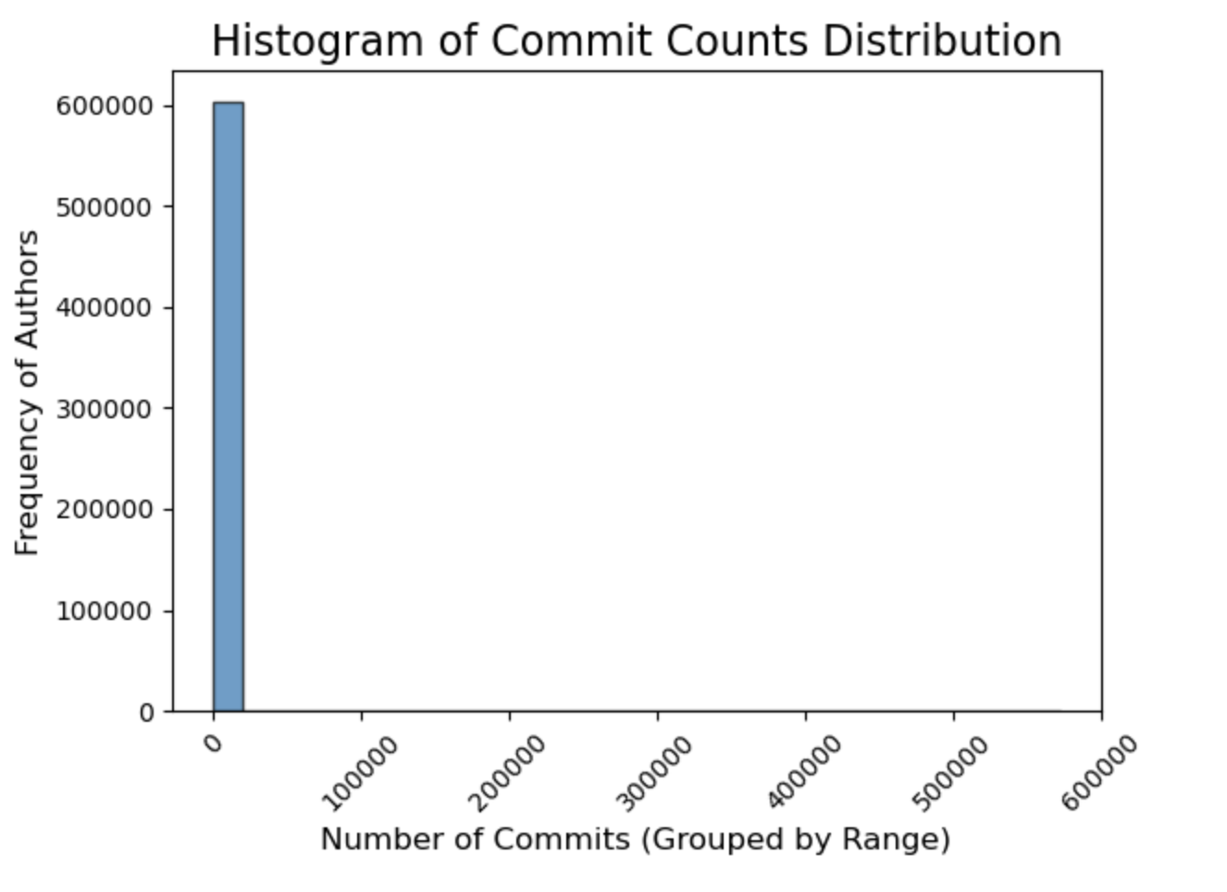
Most authors only had a tiny amount of commits while most prolific committers can make thousands of commits
* Due to scaling issues, authors with more than 10000 commits are barely visible in the graph.

Slide 12
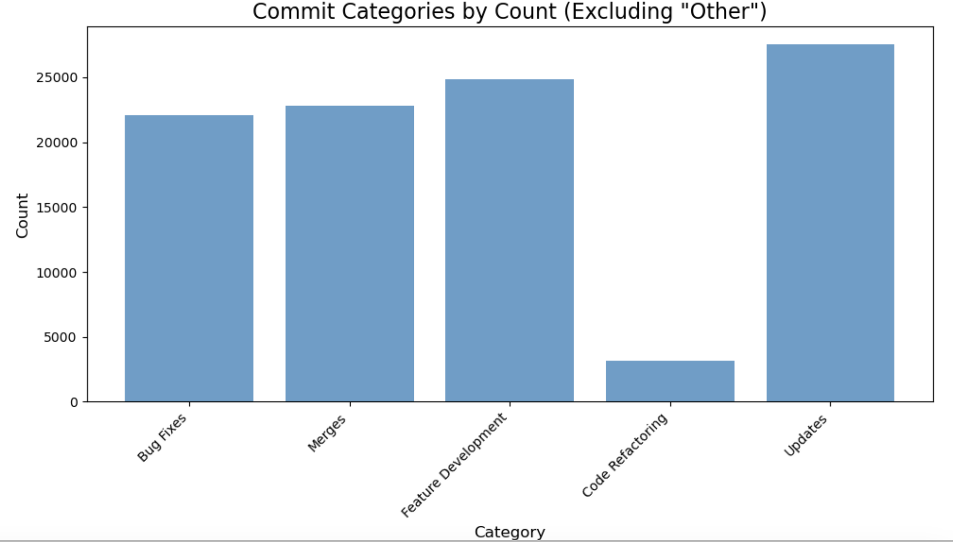
Most commits are classified as updates when categorized by the keywords used in their subjects. However, a significant number of commits remain uncategorized, indicating that similar tasks may present challenges for AI assistants
Subject keywords:
Bug fixes: fix, patch
Merges: merge
Feature development: add, implement, create
Refactor: refactor, optimize, cleanup
Update: update, modify, change

Slide 13
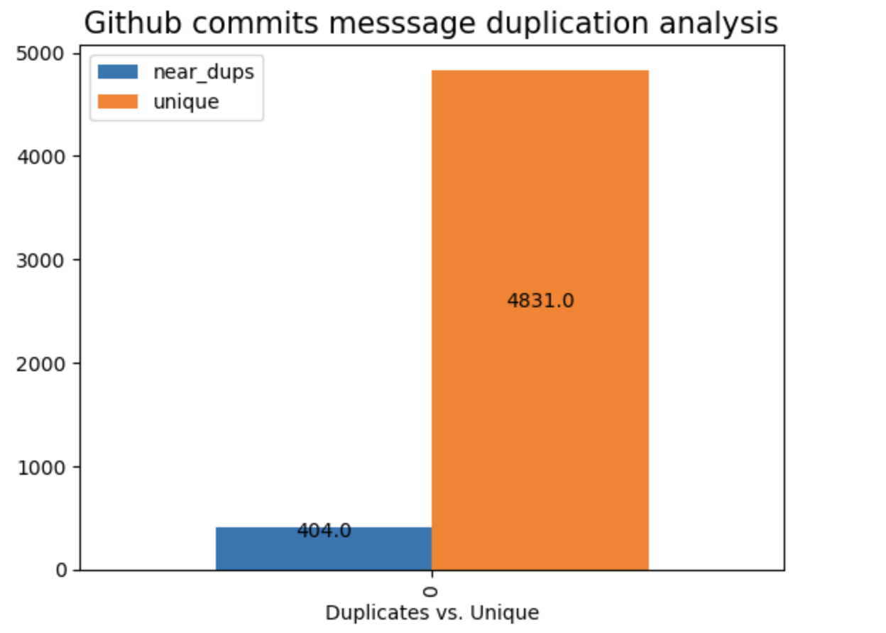
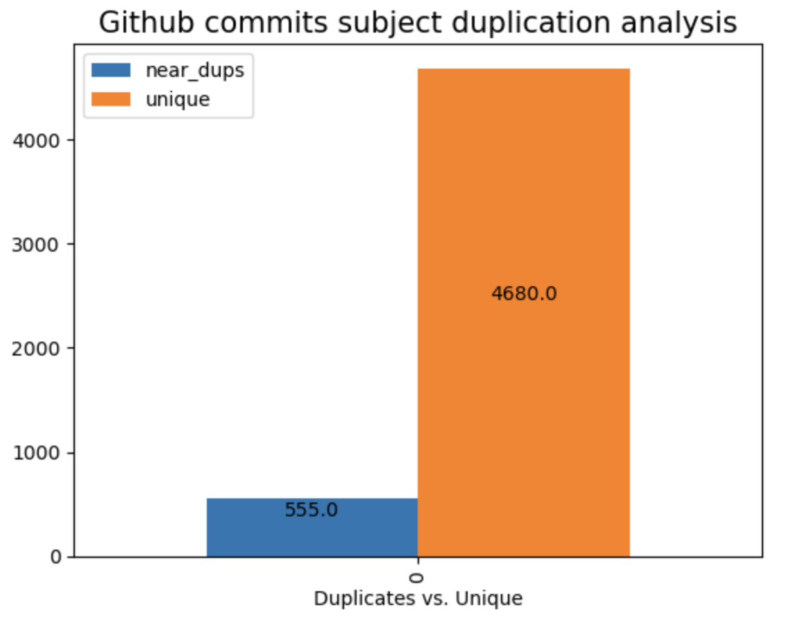
Subjects and messages had relatively few duplicates, accounting for less than 10% of the sample, with subject duplicates being more common than message duplicates under a 0.5 Jaccard distance. Other than simply copying and pasting every word, many duplicates were created by reusing the same phrases with changes to repository names or subject titles

Slide 14
The top 5 programming languages generally had a higher proportion of duplicates compared to all commits. This could be attributed to the widespread availability of open-source projects and the tendency of users to reference and reuse the work of others
* A different sample is used in this slide and the slide before, so the duplication percentage is a bit different

Slide 15
Conclusions and Recommendation
Conclusion Analyzing a sample of GitHub commit data reveals that the majority of users are small-scale contributors who primarily make a limited number of commits focused on updates and maintenance tasks. These types of commits often involve repetitive changes or incremental improvements, making them ideal candidates for assistance from AI tools. AI systems can learn from prior commit patterns and effectively generate these updates, saving users time and effort.
On the other hand, developers from major organizations such as Google Chrome and contributors to projects like Linux dominate in terms of the number and significance of commits. These developers are responsible for groundbreaking contributions and intricate modifications that shape the technological landscape. Such complex, creative work is less suitable for AI assistance and instead requires human ingenuity and expertise to ensure quality and innovation.
Recommendations
Use AI for Routine Tasks: AI tools should handle repetitive updates like bug fixes, dependency updates, and code formatting.
Preserve Human Creativity: Complex, innovative work should remain human-driven to ensure quality and originality.
Adopt Hybrid Workflows: Combine AI assistance with human oversight for balanced productivity and innovation.

